Slide 1

APEX MANUFACTURING & CONSUMER SOLUTIONS
End-to-End Organizational Development & HR Turnaround Strategy
Supervised by Dr. Marwa Agha | Complete 7-Task Turnaround Strategy: Rightsizing, 4-Tier Structure & HR Systems.
Headcount
Payroll Savings
200 → 94 HC (53% reduction, -106)
$1,422,600 / yr — Monthly payroll: $226.3k → $107.75k
Span & Structure
Indirect Ratio
Span 1:10 → 1:14; 4-tier flat, lean structure
8.51% (9 HC) — well below 25% CEO ceiling
AAST • Team 1 | Supervised by: Dr. Marwa Agha

Slide 2
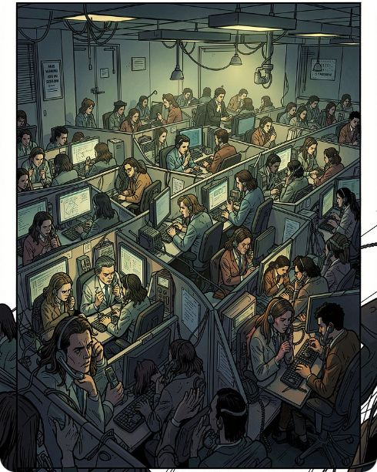

Strategic Overview
Executive Summary & Turnaround Transformation Scorecard
Transforming a 200-HC operational crisis into a validated 94-HC lean operating model.
Before: Operational Crisis
After: Stabilized & Lean
• 200 staff across 7 redundant layers
• $226.3k/mo wage drain ($2.72M/yr)
• 38% turnover & 45% 90-day churn
• Revenue down 33%, CSAT collapsed to 62%
• Lean 94 staff in flat 4-tier hierarchy
• $1.42M/yr savings (71.13M EGP, -52.4%)
• Turnover stabilized ≤12% (18-day hire)
• 100% quarterly weighted KPI scorecards
AAST • Team 1 | Supervised by: Dr. Marwa Agha

Slide 3
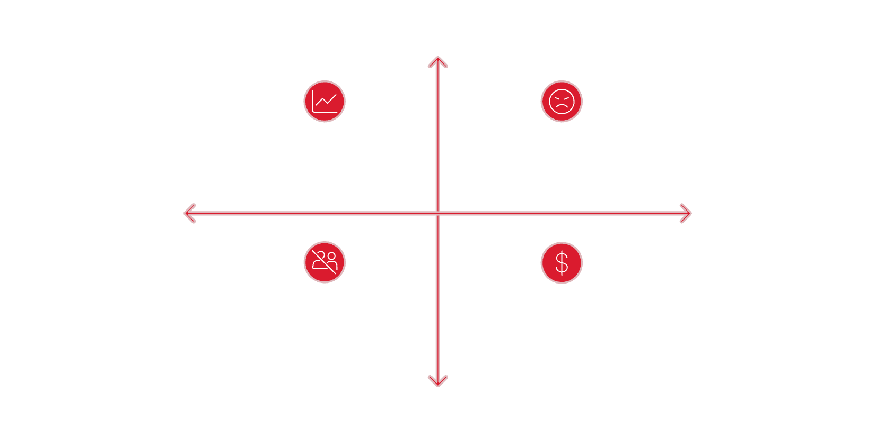
Diagnostics & Root Causes
High Severity
Revenue: $15M ➔ $10M (-33.3%) — Unmotivated sales reps with flat pay and delivery delays.
CSAT: 88 ➔ 62 (-29.5%) — Severe call center queue delays and factory defect rates.
Turnover: 15% ➔ 38% — Severe pay compression and lack of career growth paths.
90-Day Churn: 8% ➔ 45% (5x) — Zero formal onboarding and day-one role ambiguity.
Recruitment cost: $800–$1.2k → $3.2k (+200%) — root cause: panic agency hiring and long time-to-fill.
Revenue collapse
CSAT decline
Low Urgency
High Urgency
High turnover
Recruitment cost spike
Low Severity
Macro diagnostics summarize the burning platform and prioritized root causes.
AAST • Team 1 | Supervised by: Dr. Marwa Agha

Slide 4
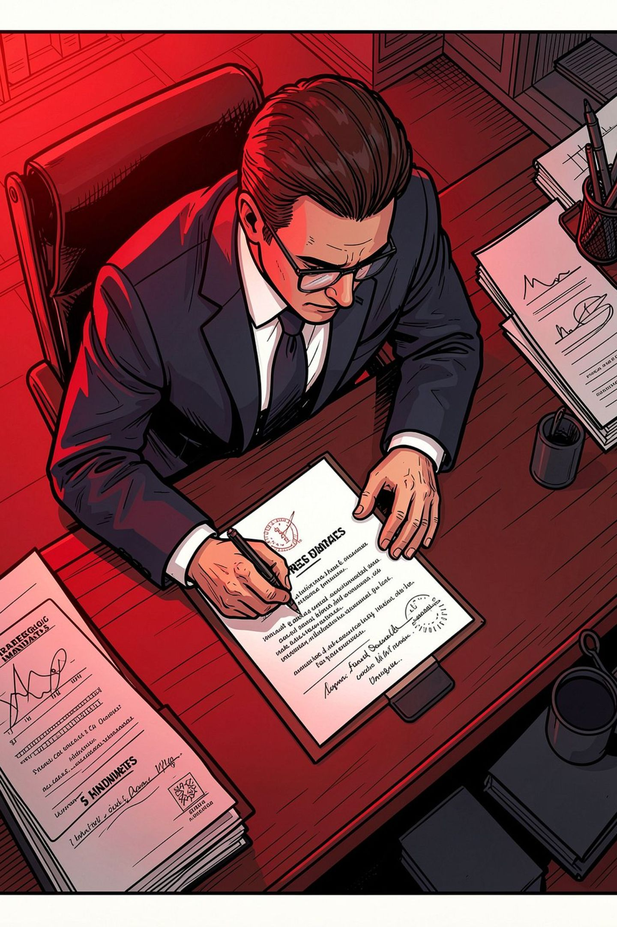
Executive Rules & Compliance
CEO strategic mandates define hard constraints and compliance checks: headcount & payroll ceilings, hierarchy flattening, workload modeling, and overhead ratio control.
Mandate 1 — Headcount & Payroll
Mandate 2 — Flattening & Spans
Target HC ≤ 100 in 90 days | Payroll ~$107k/mo
Status: PASS (94 HC | $107,750/mo)PASS (94 HC)
Max 4 layers | Frontline span ≥ 1:6
Status: PASS (4 Tiers | 1:12.5 avg frontline span)PASS
Mandate 3 — Workload Modeling
Mandate 4 — Overhead Ratio
Workload math drives all staffing with legal shift buffers
Status: PASS (Call Center & Factory math)PASS
Indirect staff ≤ 25% of total headcount
Status: PASS (9 Indirect = 8.51% of 94 HC)PASS
AAST • Team 1 | Supervised by: Dr. Marwa Agha

Slide 5

Workload Modeling — Contact Center
• Inbound Workload: 2,400 calls/day × 4.5 min AHT = 10,800 required minutes/day.
• Agent Net Capacity: 480m shift − 75m breaks = 405 productive mins. Staffing: 10,800 / 405 = 26.67 → 28 agents (includes +1 buffer).
• Department Total: 28 agents + 4 leadership = 32 HC (down from 60, −46.7%). Sustainable 85 calls/agent/day, 100% legal compliance.
AAST • Team 1 | Supervised by: Dr. Marwa Agha

Slide 6
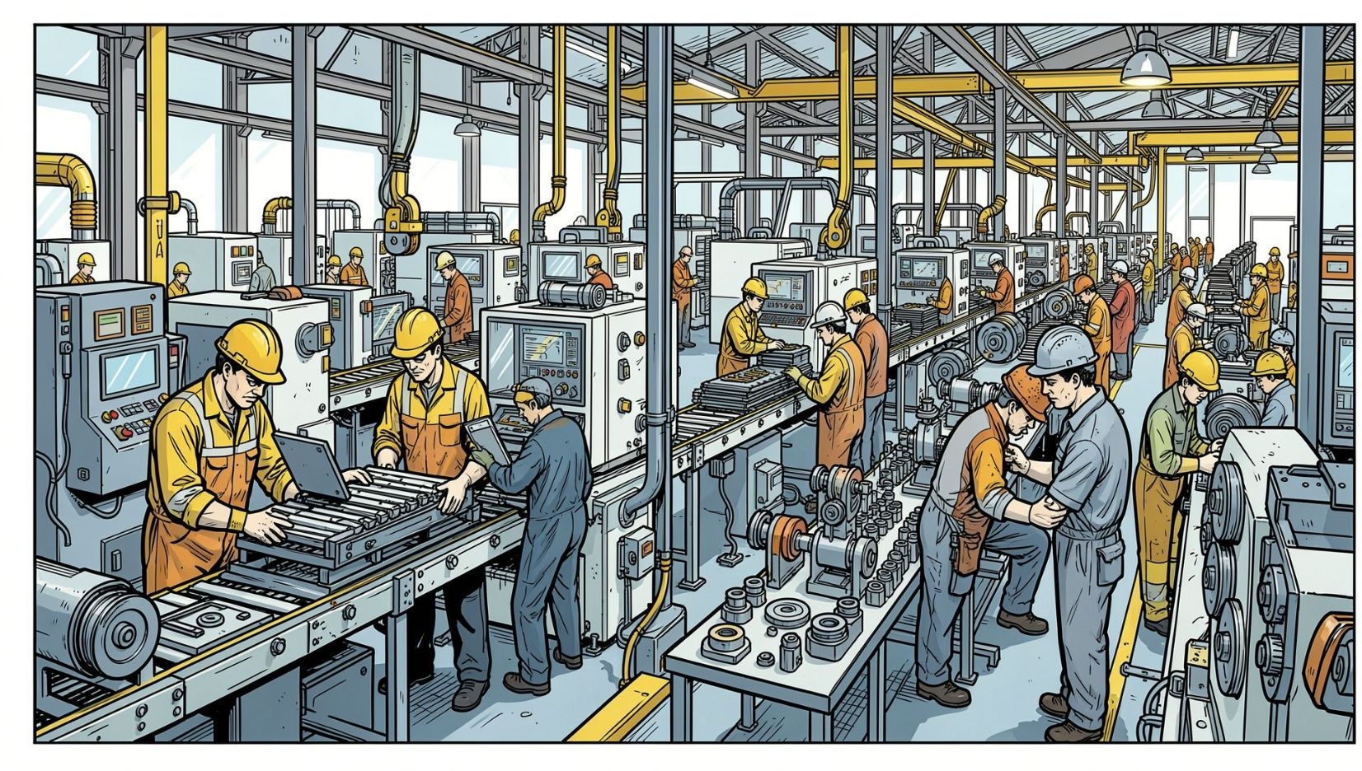
Workload Modeling — Production & Sales
• Factory Target: 10,000 units/day ÷ 400 units/worker = 25 workers + 2 floaters = 27 workers. Supervisory: 2 line sups + 1 plant manager → total ops HC = 30 (from 57; −47.4%).
• Commercial Target: $10M revenue ÷ $500k quota = 20 field reps. Field structure: 2 regional managers + VP Commercial → total sales HC = 23 (from 40; −42.5%).
• Incentives: P50 base salary plus tiered quarterly commissions (2–5%) to align behavior with revenue recovery.
AAST • Team 1 | Supervised by: Dr. Marwa Agha

Slide 7

Support Functions: HR & Finance Restructure
• HR (4 HC): 1 HR Manager, 1 Talent Acquisition, 1 Payroll, 1 OD/PMS (down from 18, −77.8%, ratio 1:23.5) with HRIS.
• Finance & Admin (4 HC): Finance Head, 2 Sr Accountants (Tax & AR/AP/Cost), Procurement/Admin (from 25, −84.0%).
• Overhead Compliance: Indirect staff = 9 (4 HR + 4 Fin + CEO) → 8.51% of 94 HC (well below 25% CEO ceiling).
AAST • Team 1 | Supervised by: Dr. Marwa Agha

Slide 8

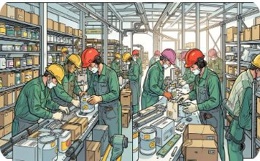


Headcount Master Plan — Consolidated
Consolidated target: Company HC 200 → 94 (−106, −53.0%). Target structure ensures operational coverage with legal buffers and clear spans.
Customer Service
Factory Production
Commercial Sales
HR & Finance
Base 60 → Target 32 (-46.7%)
28 Agents, 2 Team Leaders, 1 QA, 1 Mgr
Base 57 → Target 30 (-47.4%)
27 Workers, 2 Line Sups, 1 Ops Mgr
Base 40 → Target 23 (-42.5%)
20 Field Reps, 2 Reg Mgrs, 1 VP Sales
Base 43 → Target 8 (-81.4%)
4 HR + 4 Finance (8.51% Overhead Ratio)
AAST • Team 1 | Supervised by: Dr. Marwa Agha

Slide 9
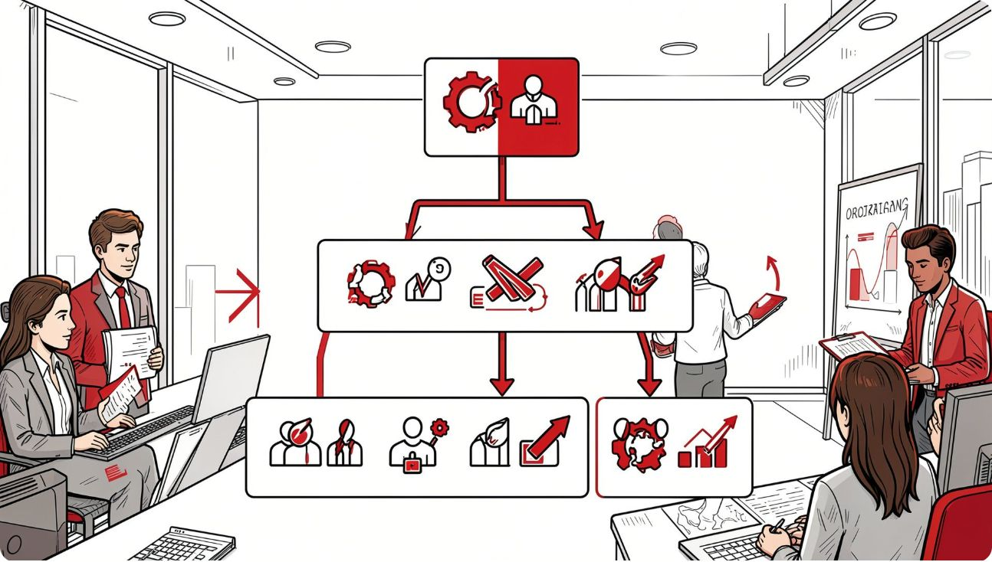
Organizational Architecture — 4-Tier Design
• Tier 1 — Executive (1 HC): CEO for turnaround governance, board interface, and enterprise P&L.
• Tier 2 — Directors (5 HC): Heads of HR, Finance, Commercial, Plant Operations, and Customer Service.
• Tier 3 — Supervisors (11 HC): Team Leaders and Shift Supervisors with wide, lean spans (1:10 to 1:14).
• Tier 4 — Frontline (77 HC): Core operations: 28 CS agents, 27 plant workers, 20 sales reps, 2 accountants.
AAST • Team 1 | Supervised by: Dr. Marwa Agha

Slide 10

Reporting Hierarchy & Headcount Matrix
Clean 4-tier hierarchy: CEO → 5 Functional Heads → 11 Supervisors → 77 Frontline Staff.
Human Resources (4 HC)
Finance & Admin (4 HC)
Commercial (23 HC)
HR Manager (Gr5) → TA, Payroll, OD (Gr2)
Finance Head (Gr5) → Sr Accountants, Procurement
VP Commercial → 2 Regional Mgrs → 20 Sales Reps (Gr3)
Operations (30 HC)
Customer Service (32 HC)
Plant Ops Mgr → 2 Line Sups → 27 Workers (Gr1)
CS Manager → 2 Team Leaders → 28 Agents (Span 1:14)
Next steps: Complete severance, deploy HRIS portal, launch 30-60-90 onboarding, and roll out quarterly KPIs.
AAST • Team 1 | Supervised by: Dr. Marwa Agha

Slide 11

Job Descriptions — 6-Section Framework
• Identification & Governance: Codified Title, Department, Job Code, Band Level, and direct superior to eliminate ambiguity.
• Strategic Purpose & Scope: Concise 2-sentence mission defining core operational purpose and turnaround value.
• Key Accountabilities & Duties: 5–7 core operational duties prioritized by output ownership and clear authority.
• Measurable KPIs & Weights: Exactly 3–5 quantitative metrics linked directly to PMS scorecards with 100% total weight.
• Competency Specifications: Required education, technical skills, certifications, and STAR behavioral proficiencies.
• Working Conditions & Safety: Shift hours, plant safety/PPE protocols, and physical travel requirements.
AAST • Team 1 | Supervised by: Dr. Marwa Agha

Slide 12
Core Position Profiles & Accountability Bands
Standardized profiles eliminate ambiguity across leadership, supervisory, and frontline tiers.
MANAGEMENT TIER • GRADE 5
HR Manager
Reports to: CEO | Band: $3,200 – $4,800
Full-cycle HR leadership, OD turnaround, compliance governance, and retention across 94 HC.
Weighted KPIs (100% Total):
• 90-Day Retention Rate: ≥ 95% (30% weight)
• PMS Cycle On-Time Delivery: 100% (25% weight)
• Recruitment SLA Adherence: ≤ 18 Days (25% weight)
• Labor & Legal Disputes: Zero (20% weight)
Core Competency: Labor law mastery, change leadership, compensation benchmarking.
SUPERVISORY TIER • GRADE 3
Plant Line Supervisor
Reports to: Ops Manager | Band: $1,400 – $2,200
Direct shift leadership, daily output quotas, scrap reduction, and shop-floor safety enforcement.
Weighted KPIs (100% Total):
• Daily Output Attainment: ≥ 10,000 units (35% weight)
• Scrap & Defect Rate: ≤ 1.2% (25% weight)
• Zero Lost-Time Accidents: 100% OHS (20% weight)
• Line Availability & OEE: ≥ 85% (20% weight)
Core Competency: Lean manufacturing, 5S compliance, shift scheduling, root-cause triage.
OPERATIONAL TIER • GRADE 1
Customer Service Agent
Reports to: Team Leader | Band: $550 – $900
Omnichannel inbound contact resolution, first-call resolution, and customer satisfaction excellence.
Weighted KPIs (100% Total):
• CSAT Score Rating: ≥ 85% (35% weight)
• First Contact Resolution (FCR): ≥ 80% (25% weight)
• Average Handle Time (AHT): ≤ 4.5 min (20% weight)
• Schedule Adherence: ≥ 95% (20% weight)
Core Competency: CRM ticketing speed, active listening, de-escalation, bilingual fluency.
AAST • Team 1 | Supervised by: Dr. Marwa Agha

Slide 13
Talent Acquisition — 18-Day Fast-Track SLA
Replaced chaotic 60-day agency hiring with a structured, competency-based 4-stage pipeline.
STAGE 1 • DAYS 1–4
Sourcing & AI Screening
• Targeted sourcing via professional networks & niche job portals.
• Standardized ATS scoring rubric against 6-section JD criteria.
• 15-minute phone screening by HR Talent Specialist.
STAGE 2 • DAYS 5–8
Work-Sample Testing
• Factory: Machine setup simulation & safety hazard audit.
• Call Center: Inbound audio simulation & CRM ticketing test.
• Commercial: 10-minute mock sales pitch & territory forecast.
STAGE 3 • DAYS 9–13
STAR Competency Panel
• Structured behavioral interview (Situation, Task, Action, Result).
• Joint hiring panel: Department Manager + HR Specialist.
• Objective 1–5 scoring rubric eliminates interviewer bias.
STAGE 4 • DAYS 14–18
Offer & Verification
• 48-hour formal offer aligned with Market P50 salary scale.
• Dual reference check & criminal record verification.
• Digital signature acceptance & pre-boarding kit dispatched.
TALENT ACQUISITION TURNAROUND METRICS
Time-to-Hire: 60 Days → 18 Days (−70.0%) | Cost-per-Hire: $3,200 → $600 (−81.2%) | 90-Day Early Attrition: 45% → < 5%
AAST • Team 1 | Supervised by: Dr. Marwa Agha

Slide 14

Talent Onboarding — 30-60-90 Day Plan
• Phase 1: Days 1–30 (Learn & Absorb): Dedicated peer buddy assigned, HR orientation, IT/ERP access, and senior shadowing.
• Phase 2: Days 31–60 (Contribute & Apply): Supervised execution on live customer tickets or factory lines; bi-weekly manager syncs.
• Phase 3: Days 61–90 (Own & Excel): Full independent quota delivery, comprehensive 90-day review rubric, and regular confirmation.
• Structured Buddy & Mentor Program: Experienced mentors guide new hires, easing early stress and accelerating integration.
• Turnaround Retention Impact: First 90-day turnover dropped from 45% to < 5%, saving $180,000+ in hiring churn.
AAST • Team 1 | Supervised by: Dr. Marwa Agha

Slide 15

HR Governance & Employee Handbook
• 10-Chapter Comprehensive Framework: Codified policies spanning work hours, overtime, conduct, leaves, and safety standards.
• Statutory Labor Law Compliance: Full compliance with 48 hrs/wk limits, overtime rates (135% day / 170% night), and leaves.
• Occupational Health & Safety (OHS): Mandatory PPE rules on the plant floor and daily 10-minute safety toolbox briefings.
• Confidential Grievance Escalation: Transparent 3-tier escalation (Supervisor → HR → CEO) with guaranteed 5-day SLA.
• Complete Legal Risk Mitigation: Replaces arbitrary penalties with documented, legally auditable compliance records.
AAST • Team 1 | Supervised by: Dr. Marwa Agha

Slide 16
Progressive Disciplinary Action Matrix
4-stage escalation ensures procedural fairness, rehabilitation, and full Labor Law Article 69 compliance.
STAGE 1 • 6-MONTH EXPIRY
Verbal Warning
Infraction Trigger:
Minor tardiness (< 15 min), dress code violation, or minor procedural non-compliance.
Corrective Action:
Private supervisory counseling session; root-cause discussion and improvement commitment.
Governance Record:
Documented counseling note signed by employee and supervisor; expires after 6 clean months.
STAGE 2 • 12-MONTH EXPIRY
Written Warning
Infraction Trigger:
Repeated Stage 1 infraction within 6 months or single unexcused absence (1 day).
Corrective Action:
Formal HR consultation; structured 30-day Corrective Action Plan (CAP) established.
Governance Record:
Official warning letter placed in HR personnel file; mandatory bi-weekly progress review.
STAGE 3 • FINAL NOTICE
Final Notice & Suspension
Infraction Trigger:
Third recurring violation or serious misconduct (safety protocol breach, insubordination).
Corrective Action:
Formal HR disciplinary hearing; 1–3 day unpaid suspension; employee right to peer representation.
Governance Record:
Final formal letter explicitly stating that any further breach results in immediate dismissal.
STAGE 4 • IMMEDIATE TERMINATION
Article 69 Dismissal
Infraction Trigger:
Fourth recurring breach or gross misconduct (theft, physical violence, fraud, deliberate sabotage).
Corrective Action:
Formal legal inquiry committee, witness statements, and CEO executive signoff.
Governance Record:
Lawful employment contract termination under Labor Law Article 69 with zero severance liability.
AAST • Team 1 | Supervised by: Dr. Marwa Agha

Slide 17

Continuous PMS & 100% Weighted Scorecards
• Agile Quarterly Review Cadence: Replaced annual appraisals with 4 quarterly cycles (Q1–Q4) and monthly coaching syncs.
• 100% Mathematically Weighted Scorecards: Exactly 3–5 quantitative KPIs per role totaling 100%; eliminates supervisor bias and ambiguity.
• Standardized 5-Tier Rating Scale: 1 (Unsatisfactory <70%), 2 (Needs Imp 70-84%), 3 (Meets 85-100%), 4 (Exceeds 101-115%), 5 (Outstanding >115%).
• Performance Improvement Plan (PIP): Mandatory 60-day structured coaching plan for low performers prior to any disciplinary transition.
• Merit-Based Rewards Linkage: Direct mathematical link between PMS rating and quarterly sales commissions, bonuses, and growth.
AAST • Team 1 | Supervised by: Dr. Marwa Agha

Slide 18
Salary Structure & Market P50 Benchmark Scale
Calibrated 6-grade salary structure aligned with Market P50 median, resolving legacy pay compression.
Grade | Level / Tier | Benchmark Positions | Min Pay | Market P50 | Max Pay | Spread | Target HC
GRADE 1 | Frontline Operations | CS Agents, Plant Machine Operators | $550 | $700 | $900 | 63.6% | 55 HC
GRADE 2 | Operational Specialists | TA Specialist, Payroll Officer, Senior Plant Tech | $850 | $1,100 | $1,450 | 70.6% | 4 HC
GRADE 3 | First-Line Supervision | Production Line Supervisors, CS Team Leaders, Sr Accountants | $1,400 | $1,750 | $2,200 | 57.1% | 6 HC
GRADE 4 | Commercial & Key Leads | Commercial Sales Reps, QA/WFM Specialist, Procurement Lead | $1,800 | $2,300 | $3,000 | 66.7% | 23 HC
GRADE 5 | Department Managers | HR Manager, Finance Head, Plant Operations Manager, CS Manager | $3,200 | $4,000 | $4,800 | 50.0% | 5 HC
GRADE 6 | Executive Leadership | VP Commercial ($6.5k–$9.5k), Chief Executive Officer ($10k–$13.2k) | $6,500 | $9,500 | $13,200 | 103.1% | 1 HC
SALARY SCALE GOVERNANCE & PRINCIPLES
15% – 25% Grade Overlap: Allows experienced frontline contributors to earn within higher ranges without artificial supervisory promotion. Eliminates internal equity friction and anchors all packages firmly to the market P50 median.
AAST • Team 1 | Supervised by: Dr. Marwa Agha

Slide 19

Financial Turnaround ROI — $1.42M Annual Savings
• Monthly Payroll Reduction (−52.4%): Monthly payroll drops from $226,300 (200 HC) to $107,750 (94 HC) — saving $118,550 every single month.
• Annual Run-Rate Cash Savings: Generates $1,422,600 in annualized cash savings (71.13M EGP), driving Apex back into operational profitability.
• Rapid Severance Amortization: One-time restructuring severance ($367,500) is fully paid back in just 3.1 months of payroll savings.
• Recruitment & Retention Dividends: Cutting turnover from 38% to 12% saves an additional $195,000 annually in agency markups and rework.
• Revenue Productivity Surge: Output per employee doubles from $50,000 to $106,383 (+112.8%), proving high operating efficiency.
AAST • Team 1 | Supervised by: Dr. Marwa Agha

Slide 20
90-Day Turnaround Implementation Roadmap
Structured 3-phase execution ensures operational continuity, legal compliance, and cultural stability.
MONTH 1 • DAYS 1–30
Rightsizing & Transition
• Execute voluntary separation & Article 69 severance packages ($367.5k).
• Deploy new 4-tier organizational hierarchy and reporting lines.
• Stabilize frontline shifts (CS 32 HC, Factory 30 HC, Sales 23 HC).
• Appoint internal talent champions to maintain operational morale.
MONTH 2 • DAYS 31–60
Governance & Alignment
• Distribute codified 10-Chapter Employee Handbook to all 94 employees.
• Adjust base compensation to Market P50 salary architecture.
• Implement 18-Day TA workflow and 30-60-90 Onboarding buddy system.
• Establish Joint Health & Safety Committee and daily toolbox talks.
MONTH 3 • DAYS 61–90
Performance & Steady State
• Roll out 100% weighted quarterly KPI scorecards across all departments.
• Conduct first monthly operational 1-on-1 performance coaching syncs.
• Audit span of control ratios (1:6 frontline) and overhead limit (8.51%).
• Transition leadership to Business-As-Usual (BAU) operating rhythm.
CAPSTONE DEFENSE READY: Full 7-Task Turnaround Package finalized for Academic Submission & Presentation to Dr. Marwa Agha — Complete 20-slide cohesive executive deck with 9-speaker scripts.
AAST • Team 1 | Supervised by: Dr. Marwa Agha

